Slide 1
C# Database Connection
Chapter Five
.

Slide 2
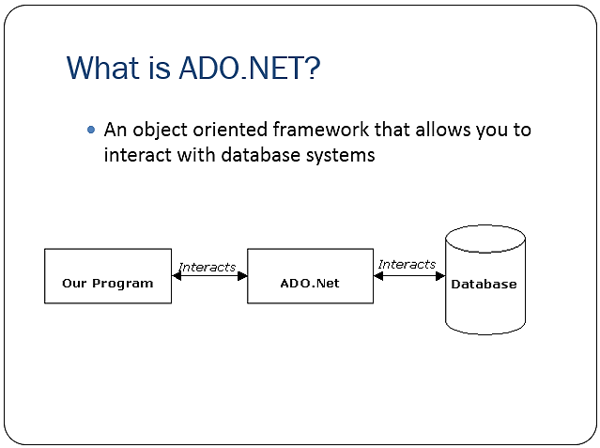
ADO.NET(ActiveX Data Object .NET )
ADO.NET is a primary data access technology for the .NET Framework that enables application to connect to data stores
Is object oriented frame work that allow you to interact with database systems
Notes:
ADo.net connect application with database It if framework platform

Slide 3
Cont…
ADO.NET provides classes that you use as you develop database application with C# and other .Net languages
These classes can be divided into two
The .NET data provider
Which provide the classes that you use to access the data in database
Dataset
Which provide the classes that you can use to work and store data in your application

Slide 4
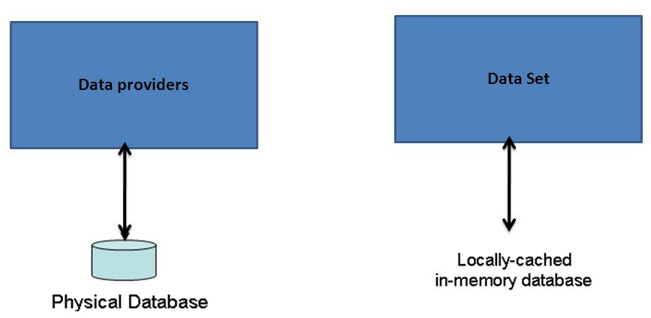
Cont…

Slide 5
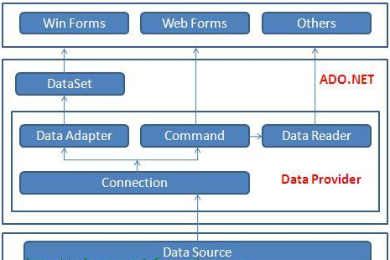
Cont.

Slide 6
A. The .NET data providers
A .NET data provider is a set of classes that enables you to access data that’s managed by a particular database server.
All .NET data providers must include core classes for creating the four types of objects.
Connection
Establishes a connection to a database server
Command
Represents an individual SQL statement that can be executed against the database
Data reader
Provides read-only forward access to the data in a database
Data adapter
Provides a link between the data source and dataset object
Notes:
Afrani olii data provider object jedhamujedhamu Data adapter Link Bn command and connections

Slide 7
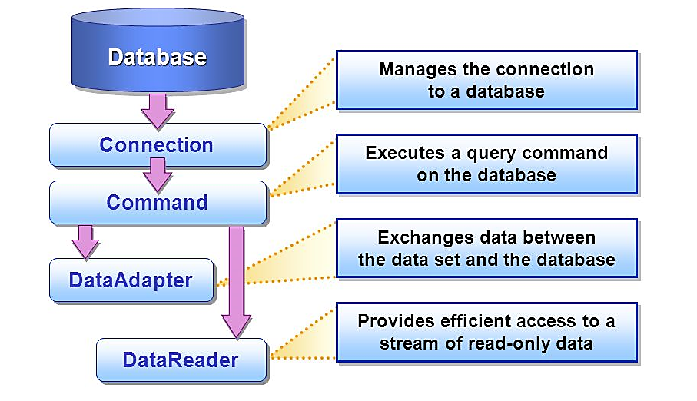
Cont…

Slide 8
Cont.
Data provider included with the .NET Framework
SQL Server
System.Data.SqlClient - Enables access MS SQL Server database
OLEDB
System.Data.OleDb - Enables access to any database that supports OLEDB
ODBC
System.Data.Odbc - Enables access to any database that supports ODBC
Oracle
System.Data.OracleClient - Enables access to Oracle database
Class name for data provider
Object SQL Server OLEDB ODBC Oracle
Connection Sql Connection OleDbConnection Odbc Connection Oracle Connection
Command Sql Command OleDb Command Odbc Command Oracle Command
Data Reader Sql Data Reader OleDb Data Reader Odbc Data Reader Oracle Data Reader
Data adapter Sql Data Adapter OleDb Data Adapter Odbc Data Adapter Oracle Data Adapter
Notes:
Oledb. You can access any database by it Sqlclient for accessing SQL server

Slide 9
Cont.
The steps for executing database command in ADO.NET are:
Create connection object
Open the connection
Create a command object encapsulating both Sql command and the connection
Call a method on the command object to execute the command
Close the connection by calling the close on the connection object
You can create ADO.NET objects
By Writing the code yourself
From data source listed in the Data Sources window
Add Data Source using Data Source Configuration wizard

Slide 10
Connection Object
Create a connection object
The Connection Object connect to the specified Data Source and open a connection between the C# application and the Data Source
In C# the type of the Connection is depend on which Data Source system you are working with
C# SQL Server Connection
C# OLEDB Connection
C# ODBC Connection
C# Oracle Connection

Slide 11
C# OLEDB Connection
OleDbConnection Object - handles the physical communication between the C# application and the Access Database.
OleDbConnection instance takes Connection String as argument and pass the value to the Constructor statement
Connection String is a normal String representation which contains Database connection information to establish the connection between Database and the Application

Slide 12
Cont…
Don’t forget to add the following namespaces at the top if they don’t exist
using System.Data;
using System.Data.OleDb; //for OleDB connection
using System.Data.SqlClient; //for sql connection
Create database using MS-Access first and connect it to your application using Server Explorer

Slide 13
Cont…
public partial class Form1 : Form
{
OleDbConnection cnn = new OleDbConnection(@"Provider=Microsoft.ACE.OLEDB.12.0;Data Source=C:\Users\Fan\Documents\Database1.accdb");
private void button1_Click(object sender, EventArgs e)
{
cnn.Open();
// Code here;
cnn.Close();
}
}

Slide 14
Cont…
When the connection is established, SQL Commands will execute with the help of the Connection Object and retrieve or manipulate the data in the database.
Once the Database activities over, Connection should be closed and release the Data Source resources.
conn.Close();

Slide 15
2. Command Object in ADO.NET
The Command Object in ADO.NET executes SQL statements and stored procedures against the data source specified in the C# Connection Object.
The Command Object requires an instance of a C# Connection Object for executing the SQL statements
The Command Object has a property called CommandText, which contains a String value that represents the command that will be executed against the Data Source

Slide 16
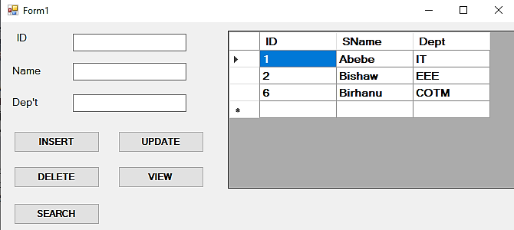
Example

Slide 17
Insert
public partial class Form1 : Form
{
OleDbConnection cnn = new OleDbConnection(@"Provider=Microsoft.ACE.OLEDB.12.0;Data Source=C:\Users\Fan\Documents\Database1.accdb");
private void insert_Click(object sender, EventArgs e)
{
cnn.Open();
OleDbCommand cmd = cnn.CreateCommand();
cmd.CommandType = CommandType.Text;
cmd.CommandText = "insert into table1 values('"+ textBox1.Text+"','"+ textBox2.Text+"','"+textBox3.Text+"')";
cmd.ExecuteNonQuery();
cnn.Close();
MessageBox.Show("Added Successfully");
}
}

Slide 18
Delete
public partial class Form1 : Form
{
OleDbConnection cnn = new OleDbConnection(@"Provider=Microsoft.ACE.OLEDB.12.0;Data Source=C:\Users\Fan\Documents\Database1.accdb");
private void delete_Click(object sender, EventArgs e)
{
cnn.Open();
OleDbCommand cmd = cnn.CreateCommand();
cmd.CommandType = CommandType.Text;
cmd.CommandText = "delete from table1 where SName='" + textBox2.Text + "'";
cmd.ExecuteNonQuery();
cnn.Close();
MessageBox.Show("Deleted Successfully");
}
}

Slide 19
Update
public partial class Form1 : Form
{
OleDbConnection cnn = new OleDbConnection(@"Provider=Microsoft.ACE.OLEDB.12.0;Data Source=C:\Users\Fan\Documents\Database1.accdb");
private void update_Click(object sender, EventArgs e)
{
cnn.Open();
OleDbCommand cmd = cnn.CreateCommand();
cmd.CommandType = CommandType.Text;
cmd.CommandText = "update table1 set SName ='"+textBox3.Text+"' where SName='"+textBox2.Text + "'";
cmd.ExecuteNonQuery();
cnn.Close();
MessageBox.Show("Updated Successfully");
}
}

Slide 20
ExecuteNonQuery
The ExecuteNonQuery() is one of the most frequently used method in OleDbCommand Object
Used for executing statements that do not return result sets or any data (i.e. statements like insert data, update data, delete etc.)
Returns the no. of rows affected by the command

Slide 21
Example
public partial class Form1 : Form
{
OleDbConnection cnn = new OleDbConnection(@"Provider=Microsoft.ACE.OLEDB.12.0;Data Source=C:\Users\Fan\Documents\Database1.accdb");
private void insert_Click(object sender, EventArgs e)
{
int rows = 0;
cnn.Open();
OleDbCommand cmd = cnn.CreateCommand();
cmd.CommandType = CommandType.Text;
cmd.CommandText = "insert into table1 values('"+textBox1.Text+"','“ +textBox2.Text+"','"+textBox3.Text+"')";
rows=cmd.ExecuteNonQuery();
cnn.Close();
MessageBox.Show(rows + " Rows are affected");
}
}
7/6/2021

Slide 22
3. Data-Reader
Data-Reader Object in ADO.NET is a stream-based, forward-only, read-only retrieval of query results from the Data Sources, which do not update the data.
The Data-Reader cannot be created directly from code, they can be created only by calling the Execute-Reader method of a Command Object.
All DataReaders (SqlDataReader, OleDbDataReader) are connected to the database.
Reads only one record at a time.
Does not remember previous record. Forward-only stream reading.
Can’t perform sorting, filtering or counting of the resulting set.
A minimal server memory usage.

Slide 23
OleDbDataReader
OleDbDataReader Object provides a connection oriented data access to the OLEDB Data Sources through C# applications.
ExecuteReader() - populate an OleDbDataReader Object based on the SQL statements passed through the OleDbCommand Object.
OleDbDataReader oledbReader = oledbCmd.ExecuteReader();
The Read() method in the OleDbDataReader is used to read the rows from the OleDbDataReader and it always moves forward to a new valid row, if any row exist.
DataReader.Read();

Slide 24
Cont…
DataReader has methods and properties that you can call to iterate over the result set, such as
GetValue
GetName
Read
GetDecimal …

Slide 25
Cont…
public partial class Form1 : Form
{
OleDbConnection cnn = new OleDbConnection(@"Provider=Microsoft.ACE.OLEDB.12.0;Data Source=C:\Users\Fan\Documents\Database1.accdb");
private void button1_Click(object sender, EventArgs e)
{
cnn.Open();
OleDbCommand cmd = cnn.CreateCommand();
cmd.CommandType = CommandType.Text;
cmd.CommandText = "select * from table1";
OleDbDataReader reader = cmd.ExecuteReader();
while (reader.Read())
{
MessageBox.Show(reader.GetValue(0) + " - " + reader.GetValue(1) + " - " + reader.GetValue(2));
}
cnn.Close();
}

Slide 26

4. Data Adapter
The Data-Adapter Object provides a bridge between the Data-Set and the Data Source.
Update Method
Fill Method

Slide 27
Cont…
Data-Set
In-memory representation of data contained in a database
Data-Set consists of a collection of Data-Table objects
Operations are performed on the Data-Set, not the data source
Performs database queries and create data tables containing the query results.
it is completely independent from the Data Source.
Data-Set provides much greater flexibility when dealing with related Result Sets.
Data source
Source of data (database)
Shows all the tables and columns

Slide 28
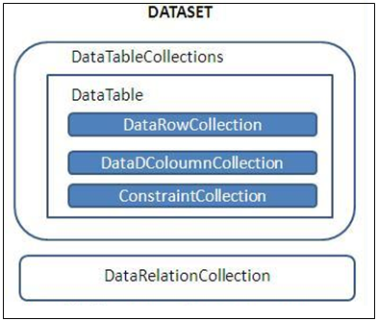
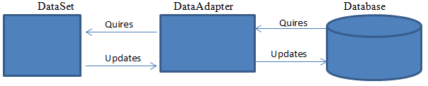
Cont…
It’s also capable of writing changes made to the DataTables back to the database.
Initializing a DataSet from a Database:
DataAdapter.Fill

Slide 29
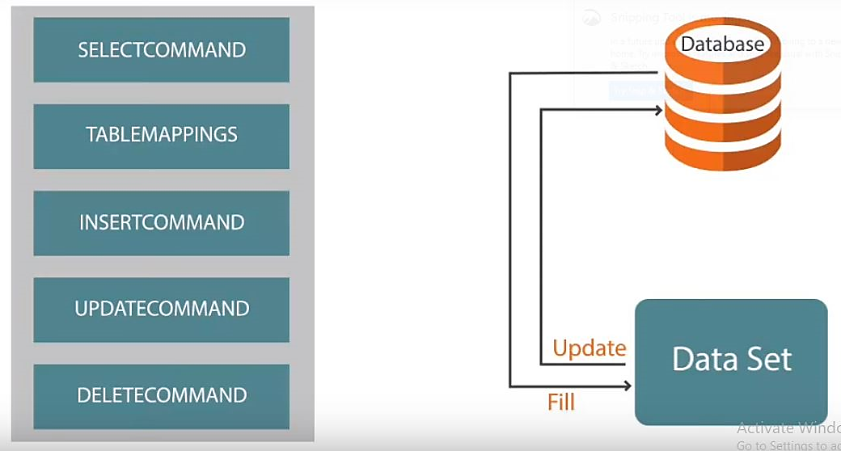
Cont…
Fill method, which changes the data in the Data-Set to match the data in the data source, and
Update method, changes the data in the data source to match the data in the Data-Set.

Slide 30
Cont…
After execution of sql command a result set or so-called record set is returned in the form of data stream.
This stream
can be read by a DataReader object or
can be pushed into a DataSet object
DataReader – reads
DataSet – holds.
DataSet caches the result set in memory

Slide 31
Example
public partial class Form1 : Form
{
OleDbConnection cnn = new OleDbConnection(@"Provider=Microsoft.ACE.OLEDB.12.0;Data Source=C:\Users\Fan\Documents\Database1.accdb");
private void view_Click(object sender, EventArgs e)
{
cnn.Open();
OleDbCommand cmd = cnn.CreateCommand();
cmd.CommandType = CommandType.Text;
cmd.CommandText = "select * from table1";
cmd.ExecuteNonQuery();
DataTable dt = new DataTable(); //DataSet Object
OleDbDataAdapter da = new OleDbDataAdapter(cmd);
da.Fill(dt); //changes the data in the DataSet to match the data in the data source
dataGridView1.DataSource = dt;
cnn.Close();
}
}

Slide 32
Search
public partial class Form1 : Form
{
OleDbConnection cnn = new OleDbConnection(@"Provider=Microsoft.ACE.OLEDB.12.0;Data Source=C:\Users\Fan\Documents\Database1.accdb");
private void search_Click(object sender, EventArgs e)
{
int count = 0;
cnn.Open();
OleDbCommand cmd = cnn.CreateCommand();
cmd.CommandType = CommandType.Text;
cmd.CommandText = "select * from table1 where SName='"+textBox1.Text+"'";
cmd.ExecuteNonQuery();
DataTable dt = new DataTable(); //DataSet Object
OleDbDataAdapter da = new OleDbDataAdapter(cmd);
da.Fill(dt); //changes the data in the DataSet to match the data in the data source
count = Convert.ToInt32(dt.Rows.Count.ToString());
dataGridView1.DataSource = dt;
cnn.Close();
if (count == 0) { MessageBox.Show("Not Found"); }
}

Slide 33
.
Thank you

